Slide 1
Internship Journey
Sean Carlo Bautista
Student Intern

Slide 2
My profile
BSEcE – Cavite States University

Slide 3
Flow of Report
Cadence Allegro
MAX78000
Building Image Classification
Dataloader
Datasets
ADTF3175D-NXZ
Azure Kinect
Accuracy
Model
Outline
Major bullet
Hardware dev
Machine Learning
TOF

Slide 4
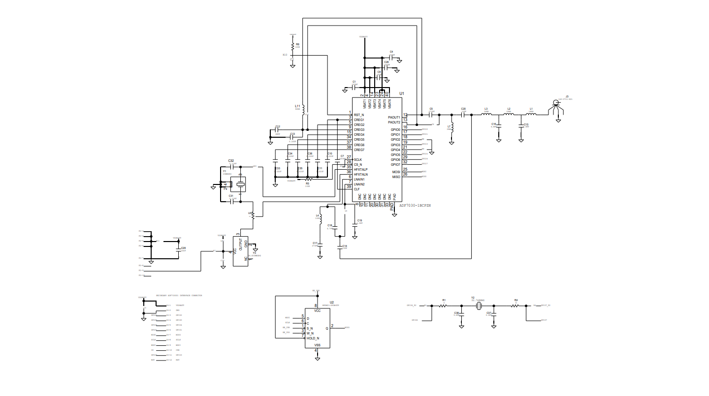
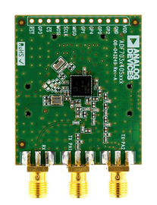
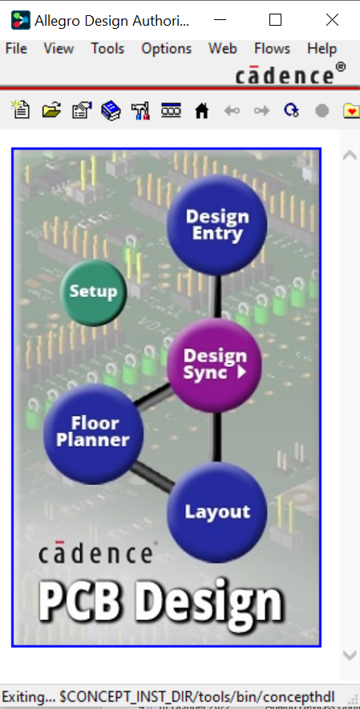
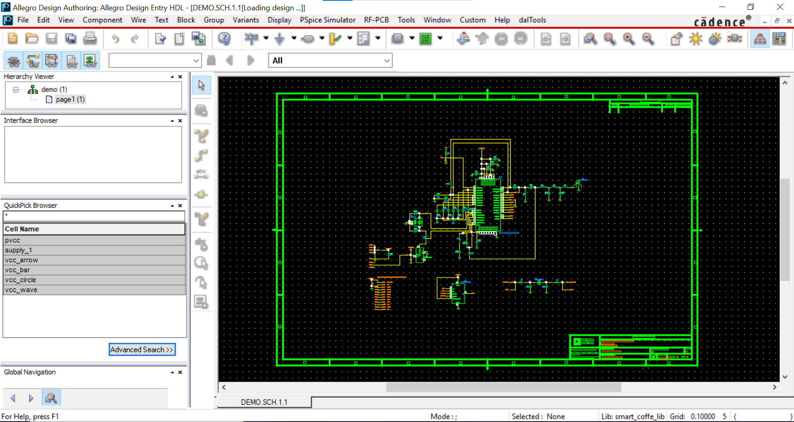
Cadence Allegro/Hardware /Actual pic
Familiarizing on Cadence Allegro
Building Schematic Diagram
Familiarizing in IC ADF7030-1BCPZN (Radio Transceiver IC)

Slide 5
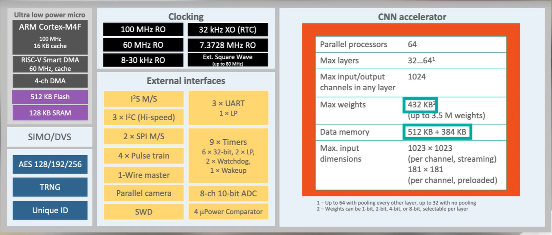
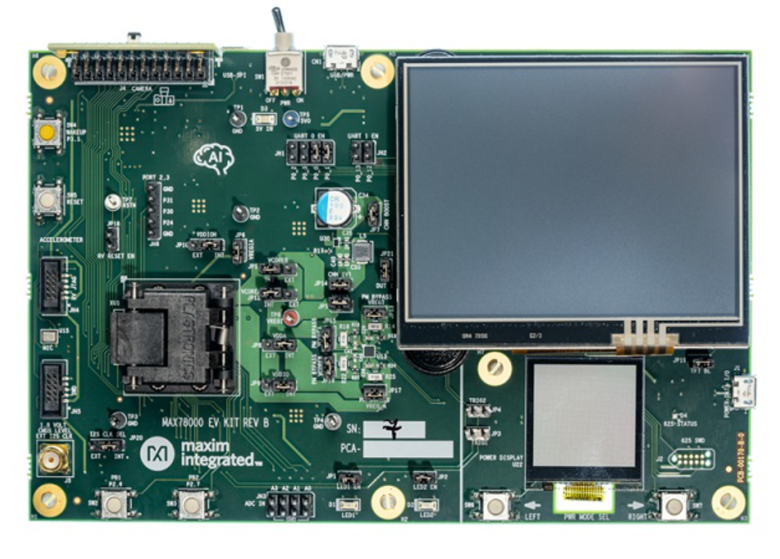
MAX78000/Overview ng hardware/ML
Familiarizing on the Device and Its Repository
Flashing different Image Processing that are from Repository

Slide 6
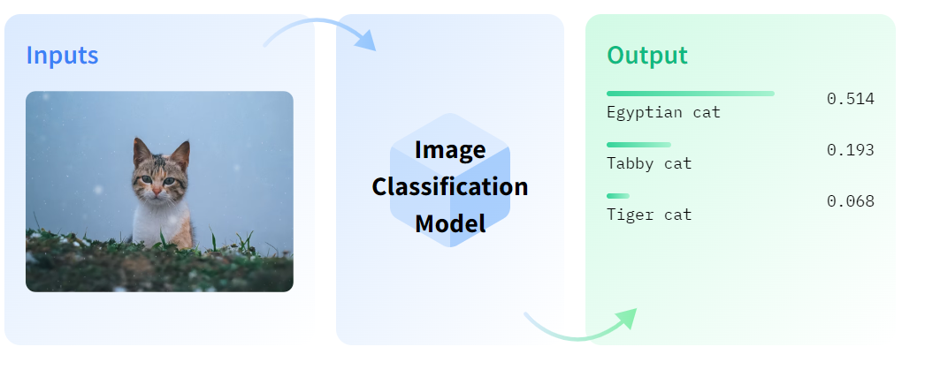
Building Your Own Image Classification
Yoga Position Classification
Building DataLoader from Scratch
DataSets
Model
Accuracy
SUB BULLET /MAJOR BULLET

Slide 7
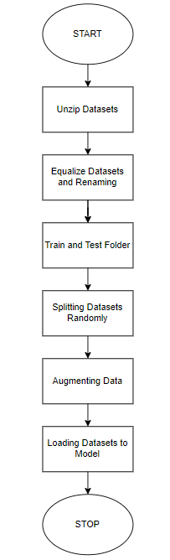
Data Loader
FLOW CHART

Slide 8
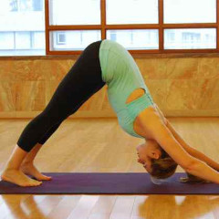
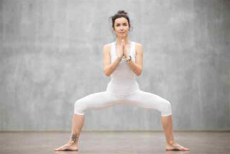
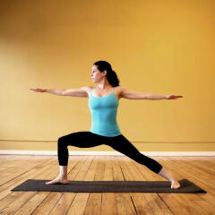
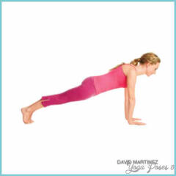
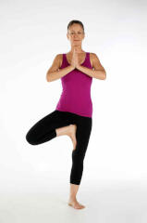
Datasets of Yoga Pose
Open Source Datasets from Kaggle.com
196 images each classification (After Equalizing Data)
Train set having 2,340 image (After Augmenting Data)
Test Set have 200 images

Slide 9



Model
Output
Flatten
Conv2D
Conv2D
Conv2D
Conv2D
Conv2D
32x64 x 64
64x32 x 32
128x16 x 16
64x8 x 8
32x8 x 8

Slide 10
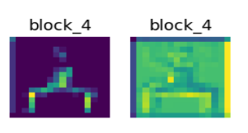
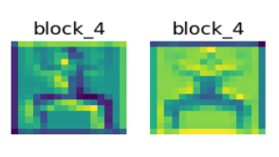
Max Pool vs Avg Pool Visualization
TAPUSIN MUNA UNG BLOX BAGO ILAGAY UNG MGA GINAWA PARA MAPATAAS YUNG ACCURACY
MAX POOLING
AVERAGE POOLING

Slide 11
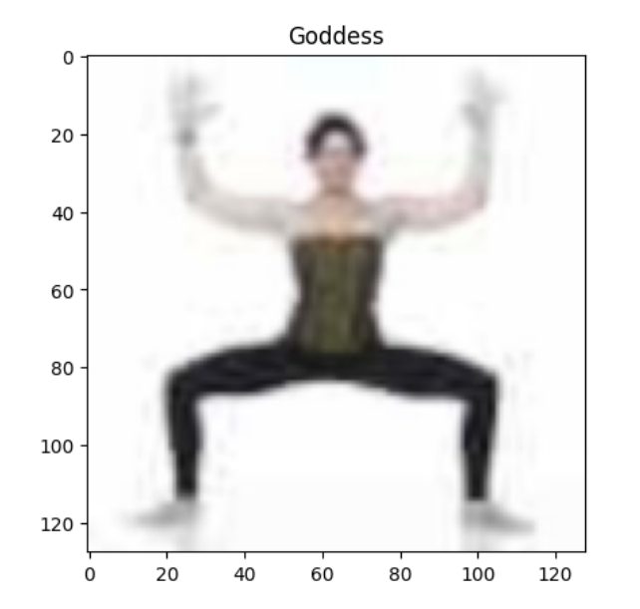
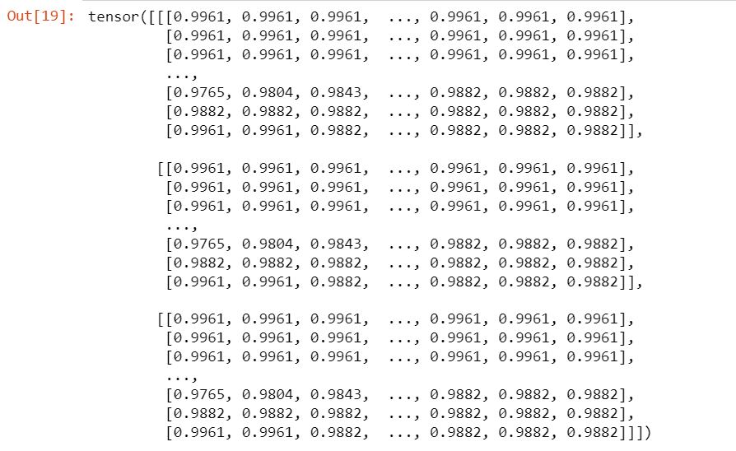
Visualization of Grayscaling

Slide 12
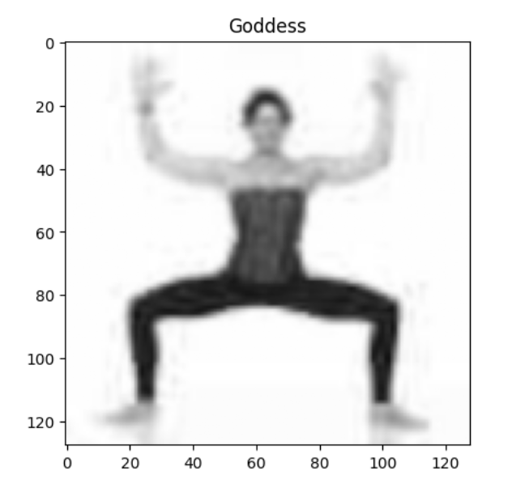
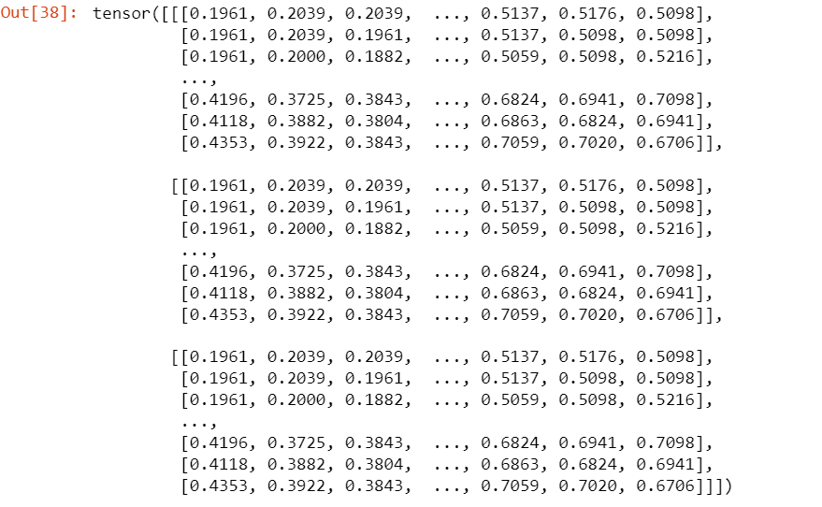
Visualization of Grayscaling

Slide 13
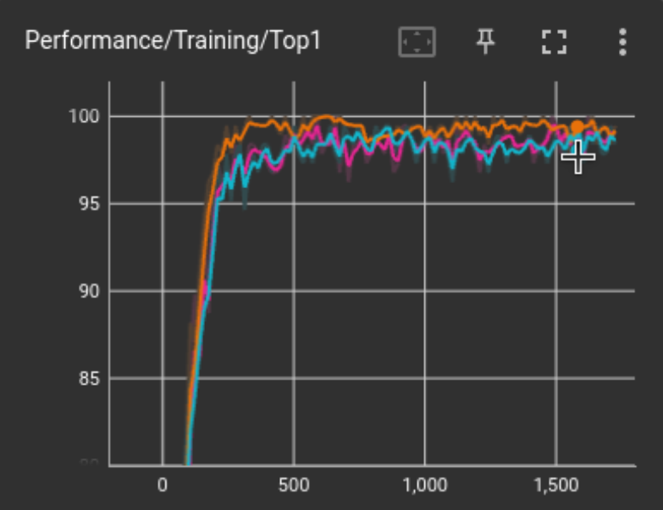
Accuracy
Cat-Dog Model =
Yoga Model w/ Avg Pooling Layer =
Yoga Model w/ Grayscale =

Slide 14
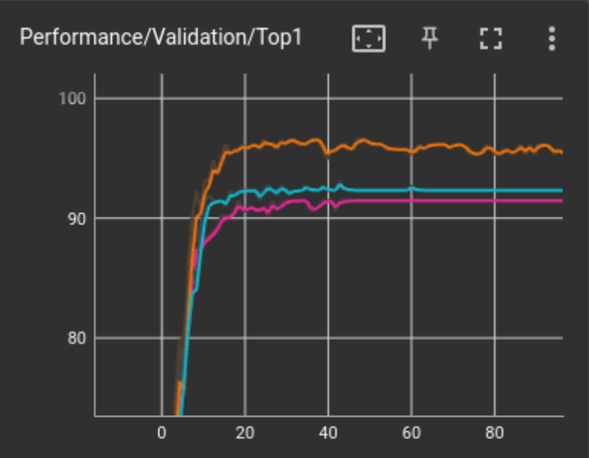
Accuracy
Cat-Dog Model =
Yoga Model w/ Avg Pooling Layer =
Yoga Model w/ Grayscale =

Slide 15
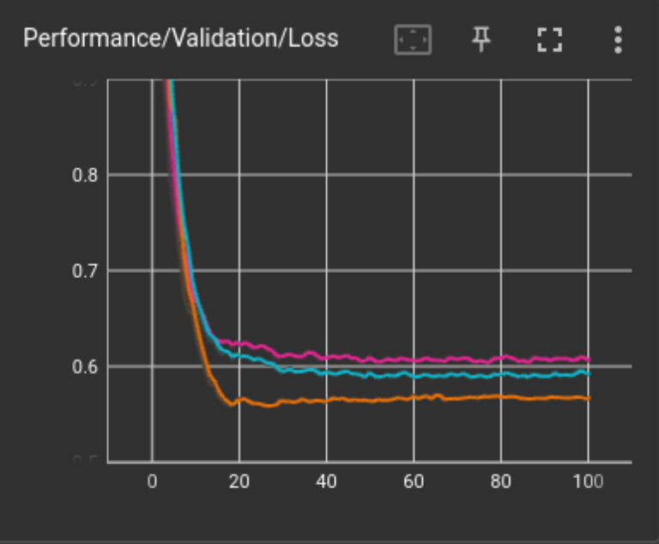
Accuracy
Cat-Dog Model =
Yoga Model w/ Avg Pooling Layer =
Yoga Model w/ Grayscale =

Slide 16
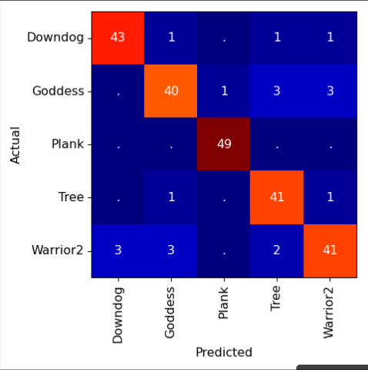
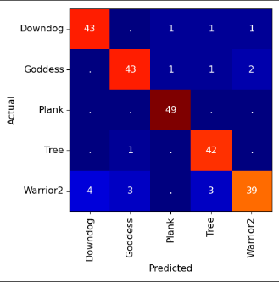
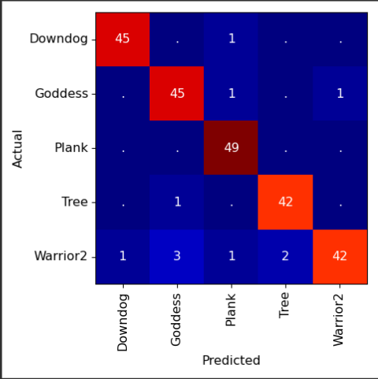
Accuracy
Cat – Dog Model(ai85net-cd)
Yoga Model w/ AvgPool
Yoga Model w/ Grayscale
Validation Accu (Overall) = 91.5%
Validation Accu (Overall) = 92.31%
Validation Accu (Overall) = 95.3%

Slide 17
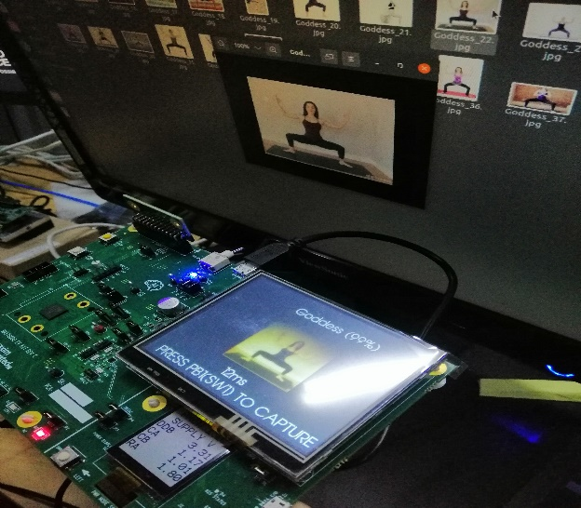
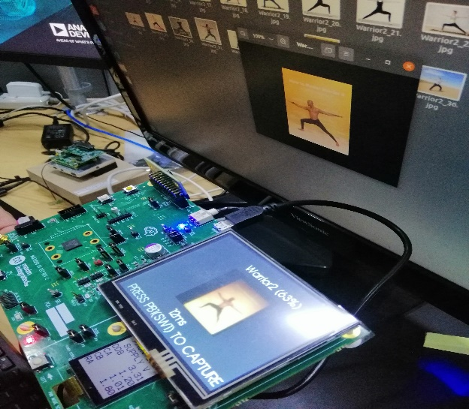
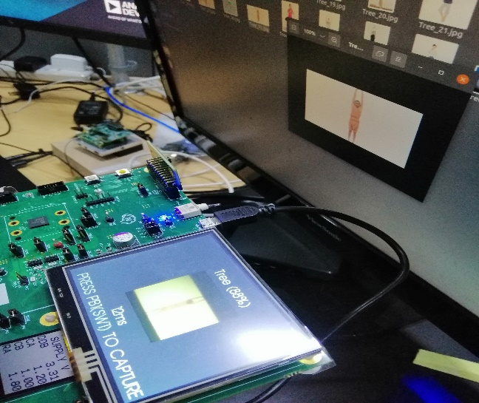
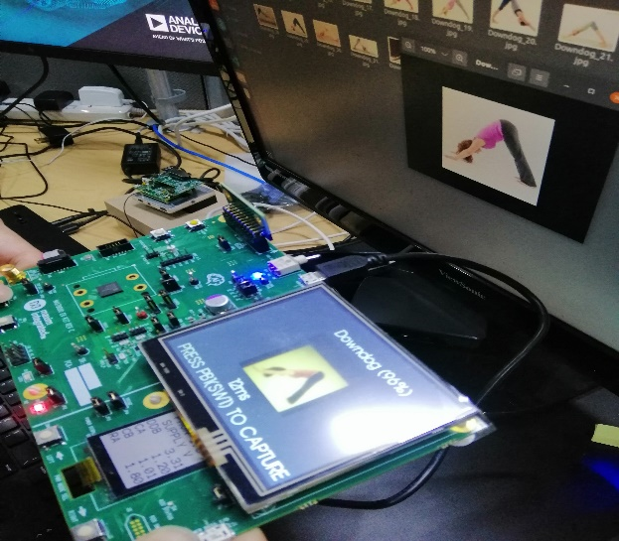
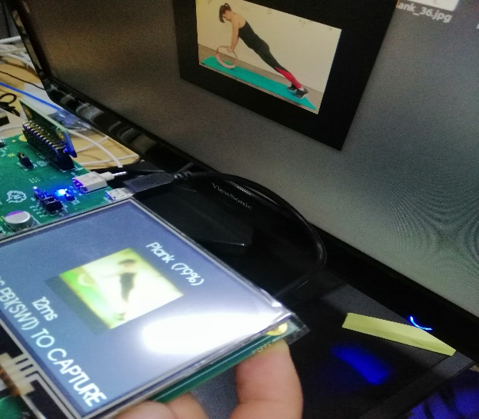
Actual Testing
Short Description

Slide 18
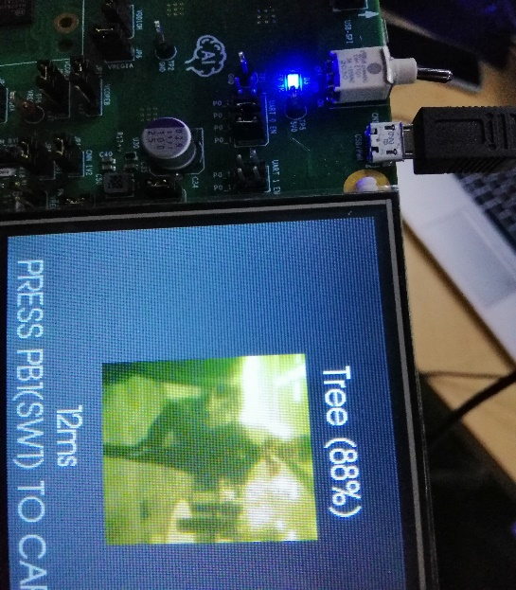
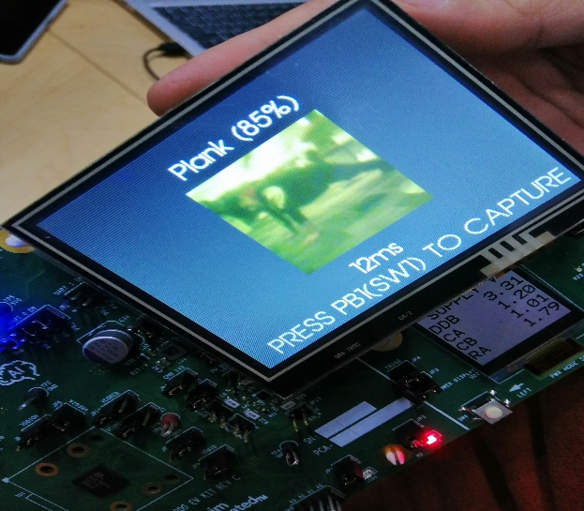
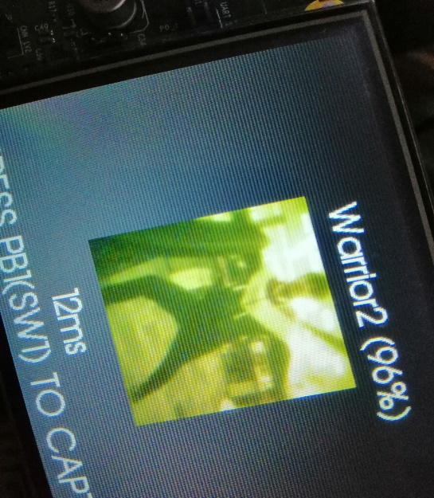
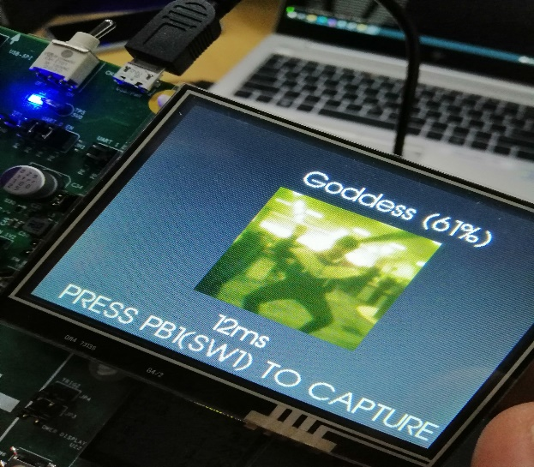
Actual Testing

